Slide 1

Android Studio
#6
Android Studio
“ Reusing a ViewModel instead of a bunch of By Remembers…“

Slide 2
INNEHÅLLSFÖRTECKNING
01
03
02
04
Översikt
Coroutines
Flow & RepeatOnLifecycle
ViewModel
FLOW

Slide 3
01
Översikt

Slide 4
ViewModel?
Screen #1
Screen #2
User Data

Slide 5
ViewModel?
Screen #1
User Data
Screen #3
Screen #2

Slide 6
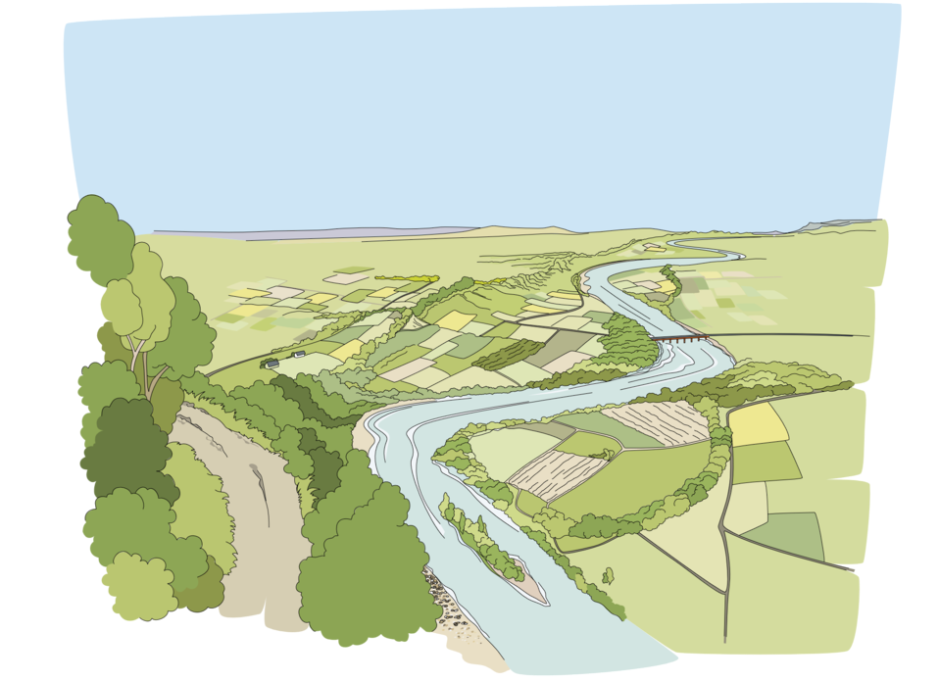
Flow?
Real-Time updates And Notifications
API and Database calls
Complex Data Processing Pipelines
Reactive/Live Data changes

Slide 7
Flow?
(Downsides)
Introduces overhead
More boilerplate code
Faster but more Error Prone
Simple UI updates, Flow becomes unnecessary
Single Values, Flow becomes unnecessary

Slide 8
02
Flow & RepeatOnLicycle

Slide 9

Dependencies
Dependencies used for this example:
// Retrofit
implementation ("com.squareup.retrofit2:retrofit:2.9.0")
// GSON
implementation ("com.squareup.retrofit2:converter-gson:2.9.0")
// ViewModel Scope
implementation("androidx.lifecycle:lifecycle-viewmodel-compose:2.7.0")
// coil - Image Loader
implementation("io.coil-kt:coil-compose:2.6.0")

Slide 10
Different Approaches
Characteristics:
mutableStateOf is a part of Jetpack Compose and is designed specifically for managing UI-related state within Compose-based applications.
It represents a single mutable value that triggers recomposition of the UI when the value changes.
mutableStateOf is not inherently lifecycle aware like LiveData and does not have built-in support for handling lifecycle events of activities or fragments.
Usage:
mutableStateOf is primarily used within composables (functions annotated with @Composable) to manage and propagate changes to UI state.
The state managed by mutableStateOf is scoped to the composition or the lifecycle of the composable function where it is used.

Slide 11
Different Approaches
MutableLiveData is an older alternative to MutableStateFlow..
Use MutableStateFlow instead for more modern approach and with work for async programming especially when working with calls.

Slide 12
Different Approaches
Use MutableStateFlow:
For managing more complex or asynchronous state changes that need to be observed across different parts of the app.
When working with ViewModels or repositories that expose state as flows for data flow and propagation.
Use mutableStateOf:
For managing simple and local UI-related state within individual composables.
When dealing with small-scale state changes or toggles that are confined to a specific part of the UI hierarchy.

Slide 13
MutableStateOf
New Data
Button Click
Application
Old State

Slide 14
MutableStateOf
New Data
Every 10 sec we get an update on data
Ständiga uppdateringar blir svårt att hantera med MutableStateFlow..
Bra tillfälle med RepeatOnLifecycle!
Application
Old State

Slide 15

MutableStateOf
Lifecycle Awareness and Memory Leaks:
Without proper lifecycle management, polling operations may continue indefinitely, even when the associated UI component or ViewModel is destroyed. This can lead to memory leaks as resources associated with ongoing polling operations are not properly released.

Slide 16

Flow
Mer stöd för
‘Coroutines’,
‘Async fetching’,
‘Data handling’

Slide 17
What about the API example?
If it’s only used ONCE?!

Slide 18
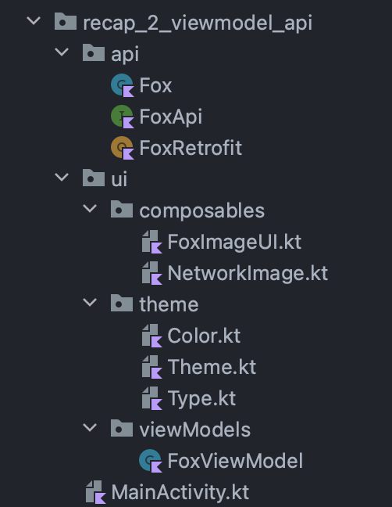
Structure of our project!

Slide 19

Retrofit
package com.krillinator.recap_1_navigation_composedestination.api
import retrofit2.Call
import retrofit2.Callback
import retrofit2.Response
import retrofit2.Retrofit
import retrofit2.converter.gson.GsonConverterFactory
import retrofit2.create
import java.lang.Exception
import kotlin.coroutines.resume
import kotlin.coroutines.resumeWithException
import kotlin.coroutines.suspendCoroutine
object FoxRetrofit {
private const val BASE_URL = "https://randomfox.ca/floof/"
private val retrofit: Retrofit by lazy {
Retrofit.Builder()
.baseUrl(BASE_URL)
.addConverterFactory(GsonConverterFactory.create())
.build()
}
private val getFoxApi by lazy {
retrofit.create<FoxApi>().getInfo()
}
suspend fun fetchFox(): Fox {
return suspendCoroutine { continuation ->
getFoxApi.enqueue(object : Callback<Fox> {
override fun onResponse(call: Call<Fox>, response: Response<Fox>) {
if (response.isSuccessful) {
val fox = response.body()
if (fox != null) {
continuation.resume(fox)
} else {
continuation.resumeWithException(Exception("Unsuccessful response: ${response.code()}"))
}
}
}
override fun onFailure(call: Call<Fox>, t: Throwable) {
println(t.message)
}
})
}
}
}

Slide 20

ViewModel
class FoxViewModel: ViewModel() {
// Define a state to hold the fetched fox object
private val _foxState = mutableStateOf<Fox?>(null)
val foxState: State<Fox?> = _foxState
fun fetchFoxImage() {
viewModelScope.launch {
try {
val fox = FoxRetrofit.fetchFox()
_foxState.value = fox
} catch (e: Exception) {
// Handle failure
println("Network request failed: ${e.message}")
}
}
}
}

Slide 21
viewModelScope vs
RepeatLifecycle
viewModelScope.launch: Used within a ViewModel to launch coroutines that are scoped to the ViewModel's lifecycle. Suitable for performing asynchronous operations within ViewModels without manual lifecycle handling.
repeatOnLifecycle: Used within a lifecycleScope to execute a suspending block repeatedly based on the lifecycle state. Ideal for continuous or periodic operations that need to be lifecycle-aware and responsive to lifecycle changes

Slide 22

UI Composable
@Composable
fun FoxImageUI(viewModel: FoxViewModel = viewModel()) {
val fox by viewModel.foxUiState
// Trigger fetch on initial composition
LaunchedEffect(true) {
viewModel.fetchFoxImage()
}
if (fox != null) {
Column(
horizontalAlignment = Alignment.CenterHorizontally,
modifier = Modifier
.fillMaxWidth()
) {
Text(text = fox?.image.toString())
AsyncImage(
model = fox?.image,
contentDescription = null,
contentScale = ContentScale.Crop,
modifier = Modifier
.size(200.dp)
.clip(shape = CircleShape)
)
// NetworkImage(url = )
}
} else {
Text(text = "Loading...")
}
}

Slide 23
Main
class MainActivity : ComponentActivity() {
override fun onCreate(savedInstanceState: Bundle?) {
super.onCreate(savedInstanceState)
setContent {
Recap_2_ViewModel_APITheme {
// A surface container using the 'background' color from the theme
Surface(
modifier = Modifier.fillMaxSize(),
color = MaterialTheme.colorScheme.background
) {
FoxImageUI()
}
}
}
}
}

Slide 24
03
Coroutines

Slide 25
Coroutines
(Ordinarie func)
object AsyncFunctions {
fun testTHREE() {
println("Test THREE ")
}
}

Slide 26
Coroutines
(Concurrency)
object AsyncFunctions {
suspend fun testONE() {
delay(1000)
println("Test ONE ")
}
suspend fun testTWO() {
delay(2000)
println("Test TWO ")
}
fun testTHREE() {
println("Test THREE ")
}
}

Slide 27
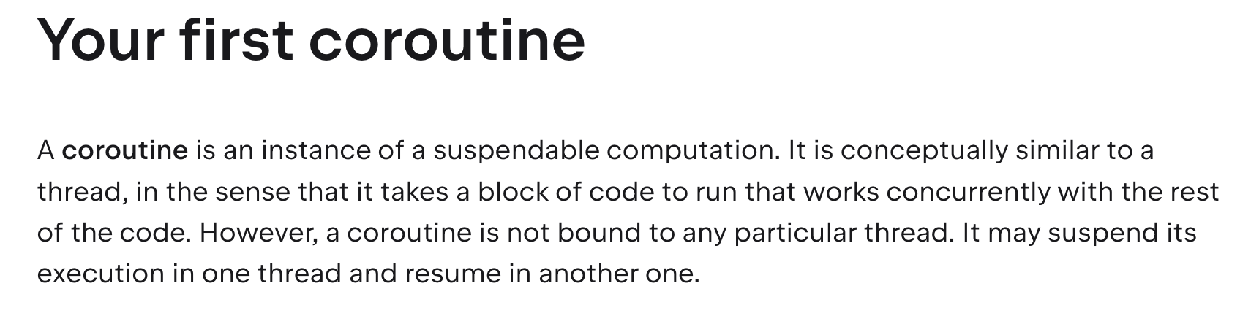
Coroutines
(Liknelse)
https://kotlinlang.org/docs/coroutines-basics.html#your-first-coroutine

Slide 28
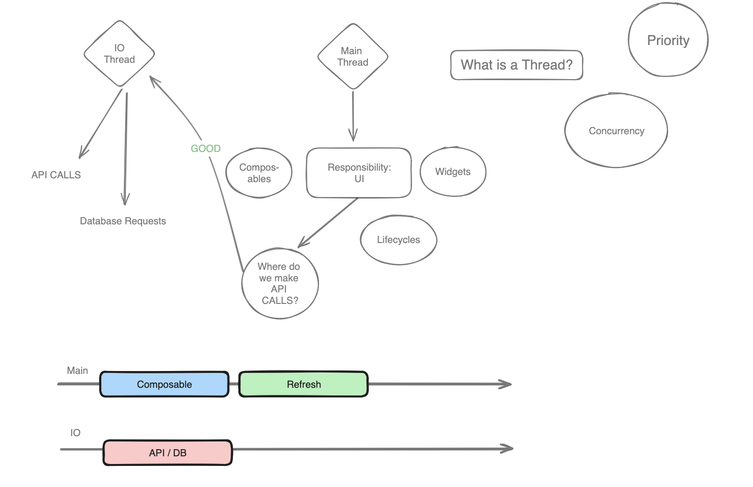
Coroutines
(Liknelse)
https://kotlinlang.org/docs/coroutines-basics.html#your-first-coroutine

Slide 29
Coroutines
(Your First Coroutine)
fun main() = runBlocking { // this: CoroutineScope
launch { // launch a new coroutine and continue
delay(1000L) // non-blocking delay for 1 second (default time unit is ms)
println("World!") // print after delay
}
println("Hello") // main coroutine continues while a previous one is delayed
}
Skriver ut “Hello World!”

Slide 30
Coroutines
(Your First Coroutine)
fun main() = runBlocking { // this: CoroutineScope
launch { // launch a new coroutine and continue
delay(1000L) // non-blocking delay for 1 second (default time unit is ms)
println("World!") // print after delay
}
println("Hello") // main coroutine continues while a previous one is delayed
}
launch is a coroutine builder. It launches a new coroutine concurrently with the rest of the code, which continues to work independently. That's why Hello has been printed first.
delay is a special suspending function. It suspends the coroutine for a specific time. Suspending a coroutine does not block the underlying thread, but allows other coroutines to run and use the underlying thread for their code.
runBlocking is also a coroutine builder. It bridges the non-coroutine world of a regular fun main() and the code with coroutines inside of runBlocking { ... } curly braces. This is highlighted in an IDE by this: CoroutineScope hint right after the runBlocking opening curly brace.

Slide 31
Coroutines
(runBlocking)
fun main() = runBlocking { // this: CoroutineScope
launch { // launch a new coroutine and continue
delay(1000L) // non-blocking delay for 1 second (default time unit is ms)
println("World!") // print after delay
}
println("Hello") // main coroutine continues while a previous one is delayed
}
The name of runBlocking means that the thread that runs it (in this case — the main thread) gets blocked for the duration of the call, until all the coroutines inside runBlocking { ... } complete their execution.
You will often see runBlocking used like that at the very top-level of the application and quite rarely inside the real code, as threads are expensive resources and blocking them is inefficient and is often not desired.

Slide 32
Coroutines
(runBlocking)
“runBlocking is a coroutine builder that is designed to bridge the gap between blocking and non-blocking code. It creates a new coroutine and blocks the current thread (in this case, the main thread) until all the code inside runBlocking completes.”
runBlocking
Main Thread
STOP

Slide 33
Coroutines
(runBlocking)
runBlocking uses the main thread and blocks it until its block of code completes.
launch (when using the default dispatcher) uses a shared pool of threads (Dispatchers.Default) for executing coroutines concurrently.
runBlocking
Main Thread
STOP

Slide 34

Coroutines
(Question #1)
Doesn't that make coroutines kind of resource hungry, since they basically say: "STOP WITH EVERYTHING THE APP IS DOING WITH THIS THREAD, I NEED TO USE IT UNTIL I'M DONE". Isn't that correct with our code example above?
Just to make sure my understanding is correct here, this is because of our FUNCTION with the runblocking coroutine with launch coroutines within. So the applications thread will have to complete our thread FIRST before moving on to the next bit of code. Correct?
YES

Slide 35
Coroutines
(Question #2)
A followup question. Let's say that the runBlocking coroutine has a suspend launched function that is called 'delay', and within the delay, we have about 3 seconds delay.
Will the application on the Main Thread at least, stop functioning for those three seconds? Or will it come BACK once those three seconds have passed, leaving room for other work to be done during the Main Thread. Or does it completely block it?
YES- we’re not blocking the main thread

Slide 36
Coroutines
(suspend)
fun main() = runBlocking { // this: CoroutineScope
launch { doWorld() }
println("Hello")
}
// this is your first suspending function
suspend fun doWorld() {
delay(1000L)
println("World!")
}

Slide 37
Coroutines
(Concurrency)
// Sequentially executes doWorld followed by "Done"
fun main() = runBlocking {
doWorld()
println("Done")
}
// Concurrently executes both sections
suspend fun doWorld() = coroutineScope { // this: CoroutineScope
launch {
delay(2000L)
println("World 2")
}
launch {
delay(1000L)
println("World 1")
}
println("Hello")
}

Slide 38

Coroutines
(async vs concurrency)
Concurrency refers to the general ability to execute multiple tasks independently and potentially overlapping in time, regardless of whether they are executed simultaneously.
Asynchronous (async) programming refers to a specific programming pattern where tasks can be executed independently from the main thread and without blocking, allowing the program to continue running while waiting for results.

Slide 39
Freeing Thread
(suspend & Main Thread)
During the delay, is the main thread freed from working with these suspend functions then?
During the delay within a suspending function, the main thread is indeed freed from actively executing that particular coroutine. This means that while a coroutine is suspended due to a delay or any other suspending operation, the main thread is not blocked and can perform other tasks or execute other coroutines concurrently.

Slide 40
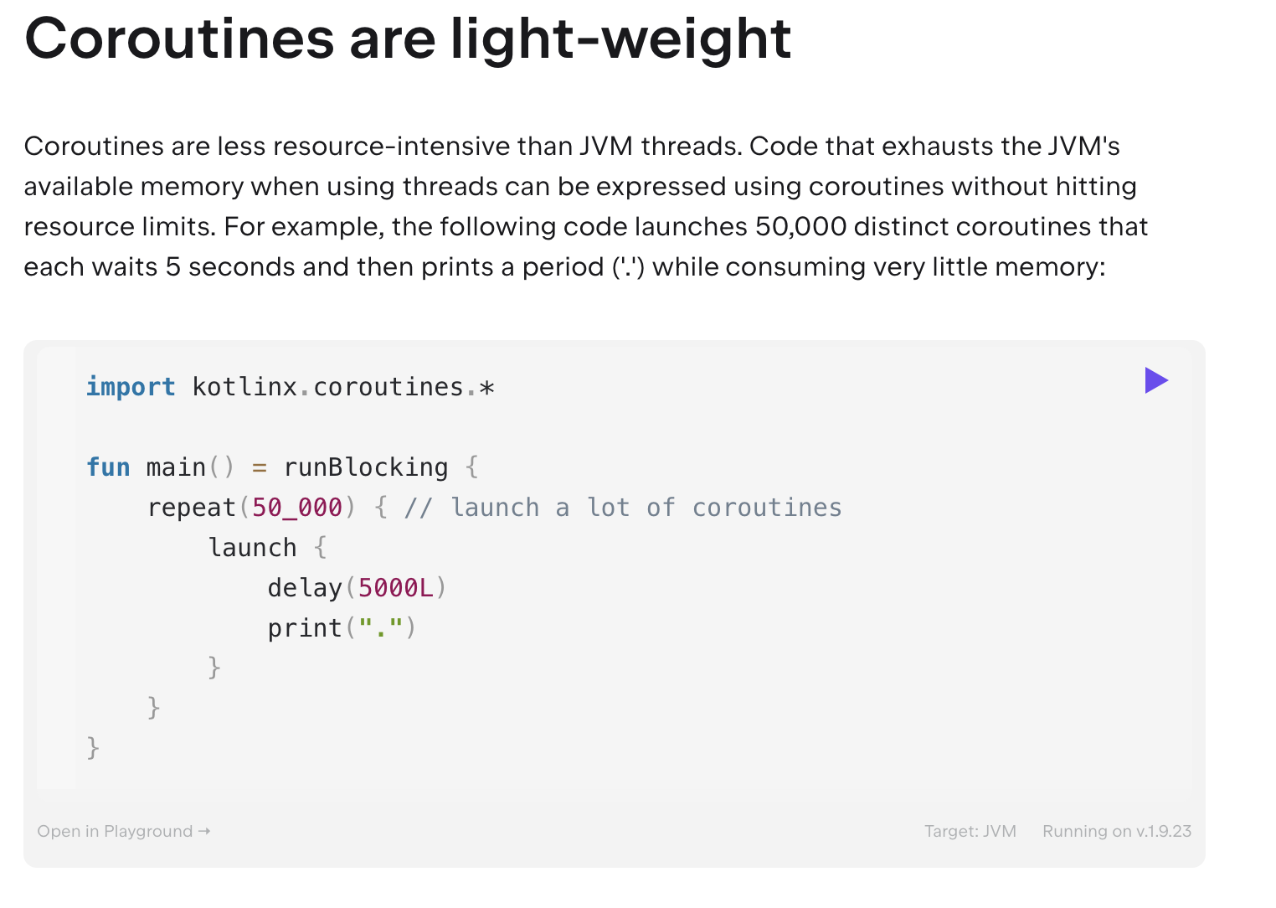
Coroutines
(async vs concurrency)
Concurrency refers to the general ability to execute multiple tasks independently and potentially overlapping in time, regardless of whether they are executed simultaneously.
Asynchronous (async) programming refers to a specific programming pattern where tasks can be executed independently from the main thread and without blocking, allowing the program to continue running while waiting for results.

Slide 41
Flow - More To Come
(Example…)
fun simple(): Flow<Int> = flow { // flow builder
for (i in 1..3) {
delay(100) // pretend we are doing something useful here
emit(i) // emit next value
}
}
fun main() = runBlocking<Unit> {
// Launch a concurrent coroutine to check if the main thread is blocked
launch {
for (k in 1..3) {
println("I'm not blocked $k")
delay(100)
}
}
// Collect the flow
simple().collect { value -> println(value) }
}

Slide 42
04
Flows & ViewModels

Slide 43
Flows
(What is it?)
FLOW
Likt en ström, så är det inte enbart en droppe som skickas vidare, det är en samling alltså en mängd vatten som förs från punkt A → B
Tänk dig en Array
“Strömmar av data flödar in kontinuerligt”

Slide 44

Flows
(Example?)
Hur hade vi uppdaterat vår UI under intervaller?
Ni kan föreställa er multipla API, databas kallelser eller en TIMER som uppdaterar sitt ‘state’ under specifika intervaller.
Detta är ej uppnåbart med ‘mutableStateOf’...
Detta kan vi lösa med FLOW!

Slide 45
Flows
(Key Points)
Observable Classes
Store & Broadcast latest value to ANY number of observers
MutableStateFlow takes in an initial value
Flows are NOT lifecycle aware just like mutableStateOf()
Coroutine encorporated

Slide 46
Flow ViewModel
(Example MutableStateOf)
In Jetpack Compose, we often use MutableState or MutableStateFlow to represent UI-related state. These are mutable variables that can hold the current state of a UI component, such as whether a button is clicked, the text in a text field, or the visibility of a view.
For example, suppose we want to represent the state of a button that can be either enabled or disabled. We can use a MutableState for this:
mutableStateOf - Något vi känner igen sedan tidigare, alltså ett ‘state’ som går att mutera (förändra värde på).

Slide 47
Flow ViewModel
(Example MutableStateOf)
Here, isButtonEnabled is a MutableState that starts with the initial value true, indicating that the button is initially enabled. We can update this state later in response to user interactions or other events:
Sedan tilldelar vi ett värde genom .value

Slide 48

Flow ViewModel
(Example Flow)
Now, let's talk about Flows.
Flows are similar to streams of data.
They allow us to emit values asynchronously over time.
We can use Flows to represent data that changes over time, such as the results of a network request, or in our case, a countdown timer.
Flow är likt en ström av data
Fisken symboliserar ‘data’ inom strömmen

Slide 49
Flow ViewModel
(Example Flow)
For example, suppose we want to create a countdown timer that emits a new countdown value every second. We can use a Flow for this:
class TimerViewModel : ViewModel() {
fun startTimer(): Flow<Int> = flow {
var count = 10 // Initial countdown value
while (count >= 0) {
emit(count)
delay(1000) // Emit countdown every second
count--
}
}
}

Slide 50
Flow ViewModel
(Example Flow)
“So, the key difference between MutableState and Flow is that MutableState is used to represent static UI-related state that can be updated synchronously, while Flow is used to represent dynamic data that changes over time and can be emitted asynchronously.”
Detta är en OK förklaring för grundläggande koncept… men vi har fortfarande inte sett ett konkret exempel på ‘state’ eller ‘mutableStateFlow’

Slide 51
viewModelscope
vs
repeatOnLifecycle

Slide 52
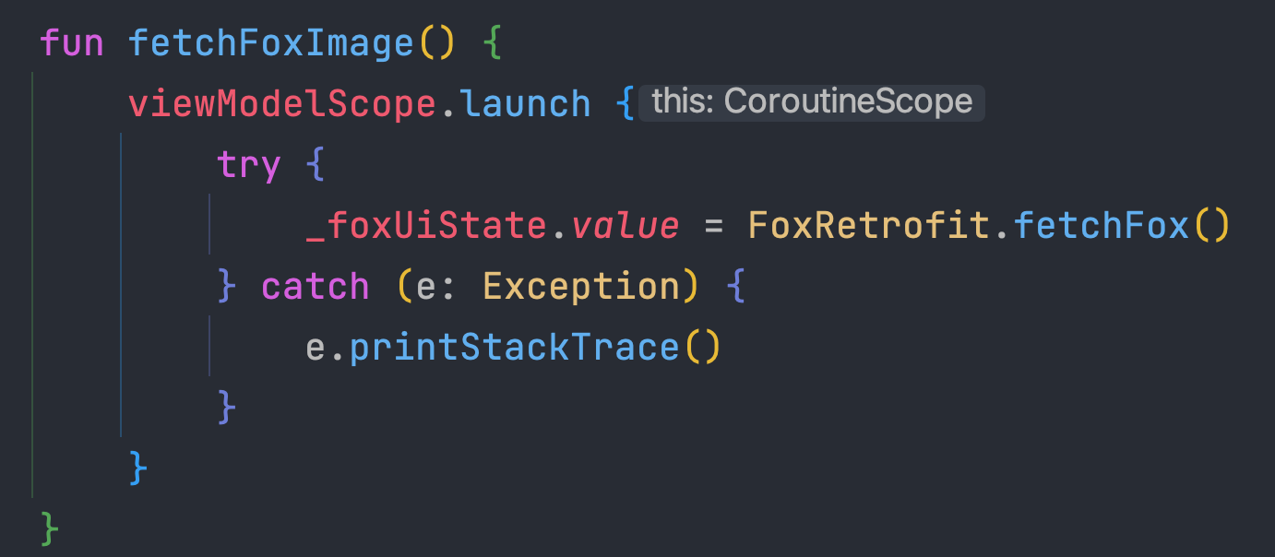
viewModelScope
(When to use)
ViewModelScope Approach:
Use viewModelScope when the coroutine's lifecycle should be tied directly to the ViewModel's lifecycle.
Suitable for tasks that are closely related to the ViewModel's responsibilities, such as fetching data from a repository, performing business logic, or managing state changes.
It provides a cleaner and more organized approach, as all coroutines related to a ViewModel are defined within the ViewModel itself.
It's particularly useful for long-running tasks or tasks that need to be cancelled when the ViewModel is cleared to avoid memory leaks.

Slide 53
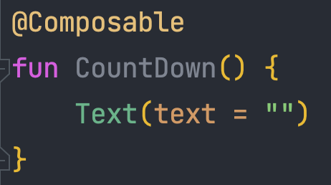
collectAsState
(When to use)
CollectAsState Approach:
Use collectAsState within Composables when you need to observe changes in StateFlow or LiveData directly in the UI layer.
It's suitable for updating the UI based on changes in the data emitted by StateFlow or LiveData exposed from ViewModels.
It allows you to separate concerns by keeping UI-related logic within Composables, making them more focused and easier to understand.
It's particularly useful for updating UI elements such as lists, text fields, or buttons based on real-time changes in data.
collectAsState() is a function provided by the compose-runtime library.
It's used to collect values emitted by a Flow and automatically recompose the UI whenever a new value is emitted.
It's useful for observing state changes and triggering UI updates in a reactive manner.
Composables are a part of the UI layer

Slide 54
repeatOnLifecycle
(When to use)
if lifecycle == onCreate()
for loop(10)
Kod stycke kan köras inom intervaller, enbart om användaren är inom en viss livscykel, detta möjliggörs med ‘repeatOnLifecycle’

Slide 55
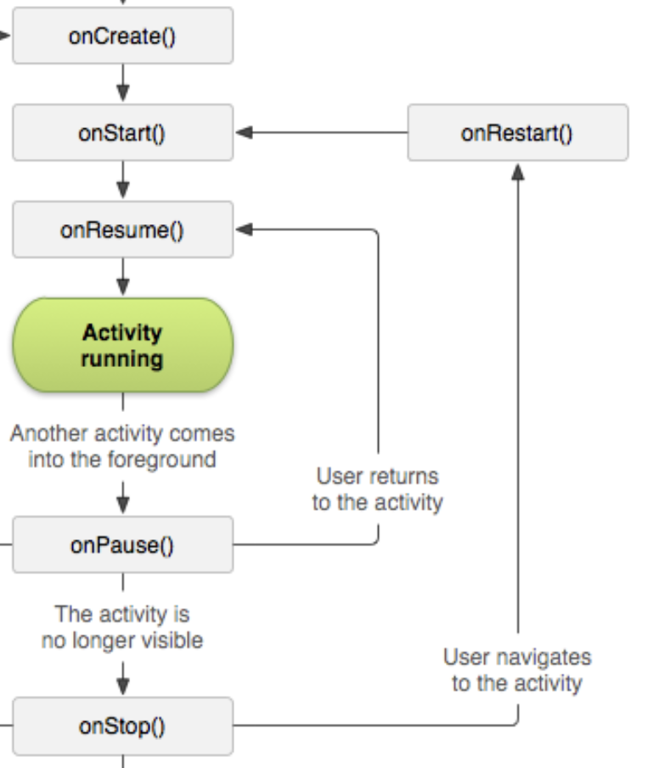
onStop() - Användaren kan navigera till onRestart() om en backar via navigationens ‘backstack’
Då kan det vara värt att köra logik inom onRestart såsom:
Load cached data
Reset State
Custom Logic
https://developer.android.com/guide/components/activities/activity-lifecycle

Slide 56
lifeCycleOwner
(When to use)
class MyUiUtility(
private val lifecycle: Lifecycle,
private val context: Context
) {
fun showToast(message: String) {
if (lifecycle.currentState.isAtLeast(Lifecycle.State.STARTED)) {
Toast.makeText(context, message, Toast.LENGTH_SHORT).show()
}
}
fun navigateTo(destination: Int) {
if (lifecycle.currentState.isAtLeast(Lifecycle.State.STARTED)) {
// Perform navigation logic here
}
}
}

Slide 57
lifeCycleOwner
(When to use)
@Composable
fun MyComposable(viewModel: MyViewModel, context: Context) {
val state by viewModel.state.collectAsStateWithLifecycle()
val lifecycle = LocalLifecycleOwner.current.lifecycle
val myUiUtility = remember { MyUiUtility(lifecycle, context) }
// Use myUiUtility to perform UI-related tasks
}
Notera hur vi passar vidare ‘context’, men viewModel håller ALDRIG reda på ‘context’ då detta kan orsaka memory leaks, problemet är löst!

Slide 58
lifeCycleOwner
(When to use)
@Composable
fun MyComposable(viewModel: MyViewModel, context: Context) {
val state by viewModel.state.collectAsStateWithLifecycle()
val lifecycle = LocalLifecycleOwner.current.lifecycle
val myUiUtility = remember { MyUiUtility(lifecycle, context) }
// Use myUiUtility to perform UI-related tasks
}
Notera att vi har något som heter ‘collectAsStateWithLifecycle som kommer från följande‘dependency’ : https://developer.android.com/jetpack/androidx/releases/lifecycle#version_28_2
Mer om detta senare…

Slide 59
lifeCycleAwareCollectAsState
(Example of Problem)
One scenario where having a lifecycle-aware collection of state can be beneficial is when you have a long-running operation, such as a network request or database query, that is triggered by a lifecycle event.
Consider the following example:
Suppose you have an activity that displays a list of items fetched from a remote server. You want to ensure that the network request to fetch the items is only executed when the activity is in the started or resumed state to avoid unnecessary network activity when the activity is not visible to the user.
Without lifecycle awareness, you might trigger the network request as soon as the activity is created or initialized. However, if the activity is stopped or paused shortly after creation (e.g., due to the user navigating away), the network request would still be executed, wasting resources and potentially slowing down the app.
By using lifecycle-aware components, such as LiveData or StateFlow with lifecycle observation, you can ensure that the network request is only executed when the activity is in the started or resumed state. This way, the request is automatically paused and resumed based on the lifecycle of the activity, leading to more efficient resource usage and better user experience.
ChatGPT

Slide 60
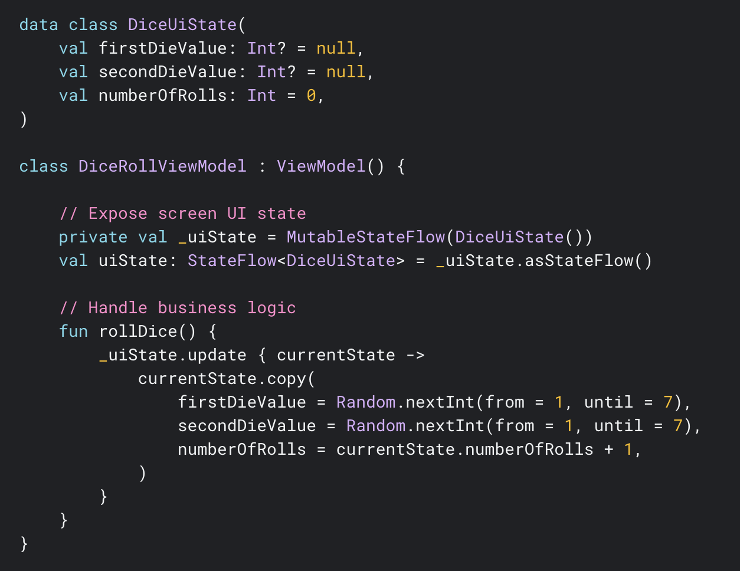
Synkron FLOW
(ViewModel Google Example)
Notera koden till vänster…
Detta är ett exempel på en SYNKRON uppdatering.

Slide 61
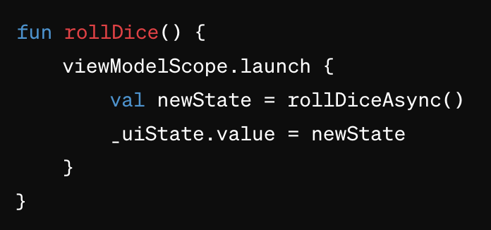
Asynkron Example
(ViewModel Google Example)
Använder vi oss av viewModelScope.launch {}
Vilket är en ‘coroutine’ (async), då slår vi på asynkron funktionalitet!
viewModelScope kommer från ett dependency:
implementation("androidx.lifecycle:lifecycle-viewmodel-compose:2.7.0")

Slide 62
repeatOnLifecycle
(XML approach, boilerplate code)
Arbetar vi inom XML måste vi ofta skriva kod som följande:
val viewModel: DiceRollViewModel by viewModels()
lifecycleScope.launch {
repeatOnLifecycle(Lifecycle.State.STARTED) {
viewModel.uiState.collect {
// Update UI elements
}
}
}
Det finns en genväg med Jetpack Compose

Slide 63
repeatOnLifecycle
(Jetpack Compose alternative)
För att hämta den säkert med ‘livscykel’ i åtanke, gör det med:
@Composable
fun DiceRollScreen(
viewModel: DiceRollViewModel = viewModel()
) {
val uiState by viewModel.uiState.collectAsStateWithLifecycle()
// Update UI elements
}

Slide 64
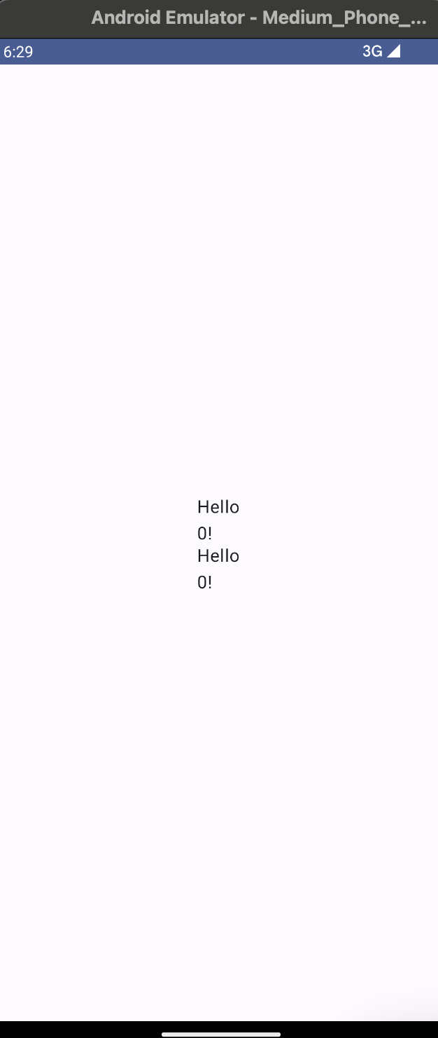
Countdown Example
(Unique ViewModels)
COPY PASTE
package com.krillinator.test_19
import android.os.Bundle
import android.os.CountDownTimer
import androidx.activity.ComponentActivity
import androidx.activity.compose.setContent
import androidx.compose.foundation.layout.Arrangement
import androidx.compose.foundation.layout.Column
import androidx.compose.foundation.layout.fillMaxSize
import androidx.compose.foundation.layout.size
import androidx.compose.material3.MaterialTheme
import androidx.compose.material3.Surface
import androidx.compose.material3.Text
import androidx.compose.runtime.Composable
import androidx.compose.runtime.LaunchedEffect
import androidx.compose.runtime.collectAsState
import androidx.compose.runtime.getValue
import androidx.compose.ui.Alignment
import androidx.compose.ui.Modifier
import androidx.compose.ui.tooling.preview.Preview
import androidx.compose.ui.unit.dp
import androidx.lifecycle.compose.collectAsStateWithLifecycle
import androidx.lifecycle.viewmodel.compose.viewModel
import com.krillinator.test_19.ui.theme.Test_19Theme
import com.krillinator.test_19.viewmodel.CountdownVM
import kotlin.math.absoluteValue
class MainActivity : ComponentActivity() {
override fun onCreate(savedInstanceState: Bundle?) {
super.onCreate(savedInstanceState)
setContent {
Test_19Theme {
// A surface container using the 'background' color from the theme
Surface(
modifier = Modifier.fillMaxSize(),
color = MaterialTheme.colorScheme.background
) {
Column {
LaunchCountdowns()
}
}
}
}
}
}
@Composable
fun LaunchCountdowns() {
val countdownViewModelONE = CountdownVM()
val countdownViewModelTWO = CountdownVM()
Column(
horizontalAlignment = Alignment.CenterHorizontally,
verticalArrangement = Arrangement.Center,
modifier = Modifier.fillMaxSize()
) {
CountdownScreen(seconds = 10, countdownViewModelONE)
CountdownScreen(seconds = 5, countdownViewModelTWO)
}
}
@Composable
fun CountdownScreen(seconds: Int, countdownViewModel: CountdownVM) {
val uiState by countdownViewModel.remainingSeconds.collectAsStateWithLifecycle()
LaunchedEffect(key1 = seconds) {
countdownViewModel.startCountdown(seconds)
}
Column(
) {
Text(
text = "Hello ${uiState}!",
Modifier.size(44.dp)
)
}
}
Två ‘countdowns’
En Börjar på 10 sek
Två börjar på 5 sek

Slide 65
Countdown Example
(viewModel() = Share)
COPY PASTE
package com.krillinator.test_19
import android.os.Bundle
import android.os.CountDownTimer
import androidx.activity.ComponentActivity
import androidx.activity.compose.setContent
import androidx.compose.foundation.layout.Arrangement
import androidx.compose.foundation.layout.Column
import androidx.compose.foundation.layout.fillMaxSize
import androidx.compose.foundation.layout.size
import androidx.compose.material3.MaterialTheme
import androidx.compose.material3.Surface
import androidx.compose.material3.Text
import androidx.compose.runtime.Composable
import androidx.compose.runtime.LaunchedEffect
import androidx.compose.runtime.collectAsState
import androidx.compose.runtime.getValue
import androidx.compose.ui.Alignment
import androidx.compose.ui.Modifier
import androidx.compose.ui.tooling.preview.Preview
import androidx.compose.ui.unit.dp
import androidx.lifecycle.compose.collectAsStateWithLifecycle
import androidx.lifecycle.viewmodel.compose.viewModel
import com.krillinator.test_19.ui.theme.Test_19Theme
import com.krillinator.test_19.viewmodel.CountdownVM
import kotlin.math.absoluteValue
class MainActivity : ComponentActivity() {
override fun onCreate(savedInstanceState: Bundle?) {
super.onCreate(savedInstanceState)
setContent {
Test_19Theme {
// A surface container using the 'background' color from the theme
Surface(
modifier = Modifier.fillMaxSize(),
color = MaterialTheme.colorScheme.background
) {
Column {
LaunchCountdowns()
}
}
}
}
}
}
@Composable
fun LaunchCountdowns() {
val countdownViewModelONE : CountdownVM = viewModel()
val countdownViewModelTWO : CountdownVM = viewModel()
Column(
horizontalAlignment = Alignment.CenterHorizontally,
verticalArrangement = Arrangement.Center,
modifier = Modifier.fillMaxSize()
) {
CountdownScreen(seconds = 10, countdownViewModelONE)
CountdownScreen(seconds = 5, countdownViewModelTWO)
}
}
@Composable
fun CountdownScreen(seconds: Int, countdownViewModel: CountdownVM) {
val uiState by countdownViewModel.remainingSeconds.collectAsStateWithLifecycle()
LaunchedEffect(key1 = seconds) {
countdownViewModel.startCountdown(seconds)
}
Column(
) {
Text(
text = "Hello ${uiState}!",
Modifier.size(44.dp)
)
}
}
val countdownViewModelONE : CountdownVM = viewModel()
val countdownViewModelTWO : CountdownVM = viewModel()
viewModel() hämtar EN instans
Dessa delar state!

Slide 66
Shared Viewmodel
(State Hoisting is a must)
Home
Om du vill att en ‘viewmodel’ ska dela data med flertal skärmar.. Definiera den högre upp inom hierarkin via ‘State Hoisting’
About
Signup
VM
val countdownViewModelTWO : CountdownVM = viewModel()
Uses same Viewmodel
Uses same Viewmodel

Slide 67
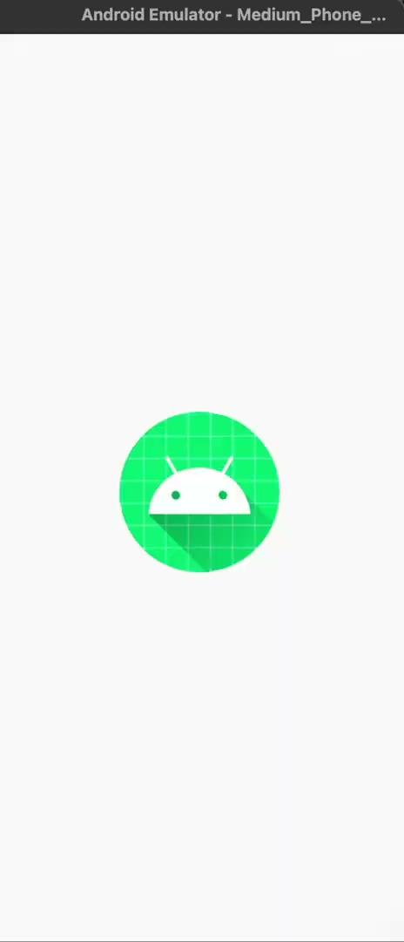
Shared Viewmodel
(Result is strange)
CountdownScreen(seconds = 10, countdownViewModelONE)
CountdownScreen(seconds = 5, countdownViewModelTWO)
Eftersom att detta körs asynkront, så börjar 10 sekunder,
Men eftersom ‘viewmodel’n hämtar från SAMMA instans,
Så ersätts 10:an med en 5:a
När 5:an har räknat ner så har 10:an räknat ner till 5, och därmed fortsätter den istället.

Slide 68
THANKS!
Do you have any questions?
kristoffer.johansson@sti.se
sti.learning.nu/
You can also contact me VIA Teams (quicker response) Du kan också kontakta mig VIA Teams (Snabbare svar)

